Slide 1

Using Machine Learning to Predict the Consequences of Climate Change
Project for ClimateWins
By Andres Gonzalez
October 25, 2025

Slide 2
The mission / Objective
 | Objective
 | Use machine learning to help predict the consequences of climate change while working as a data analyst at a European nonprofit organization.
 | Why this matters?
 | Climate change is one of the world’s biggest challenges. Predicting local effects helps communities prepare and adapt.

Slide 3
The mission / Hypotheses
01 | Hypothesis
 | If I can identify temperature patterns across European cities, then I can use them to predict local climate conditions and potential impacts of climate change.
02 | Hypothesis
 | If I use more complex models, then the predictive accuracy for climate data will increase.
03 | Hypothesis
 | If I train the models using long-term historical data, then their predictions will better capture the gradual trends of climate change over time.

Slide 4
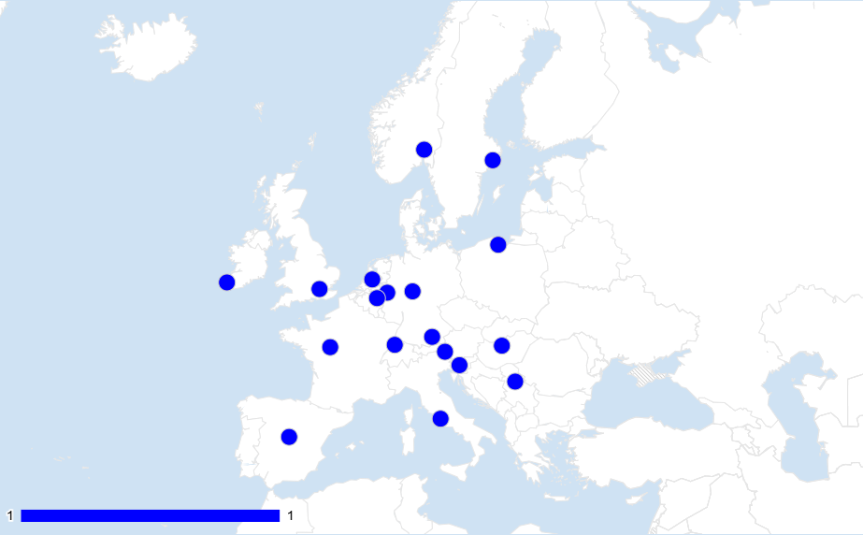
Understanding the data
Source: European Climate Assessment & Data Set project
Coverage
C
18 European cities
January 1, 1960 – October 31, 2022
Daily records of temperature, humidity, wind speed, pressure, and more
Accuracy
A
Standardized collection methods ensure reliable measurements.
Over six decades of data allow consistent long-term analysis.
Minor variations may exist between stations, but overall accuracy is high.
Potential bias
B
Regional
Human
External (political pressure)

Slide 5
How was optimization used to determine the features of the dataset?
Action
Reason
Goal:
Identify the most relevant features for predicting climate patterns
Select relevant features
To focus the model on key variables that influence temperature
Reduce features
Keep only Date, Month, and Average temperature — those most relevant for climate prediction
Expand
(KNN model) Added temp_min and temp_max to capture daily variation and climate extremes

Slide 6
What supervised learning was used and which algorithm types do you believe are most effective for your hypotheses?
K-Nearest Neighbors (KNN)
Decision Tree
Artificial Neural Network (ANN)
Compares a new data point with its closest neighbors to predict temperature patterns
Splits data into branches based on temperature and month conditions — interpretable and transparent
Mimics how the human brain processes data, learning complex, non-linear relationships between features

Slide 7
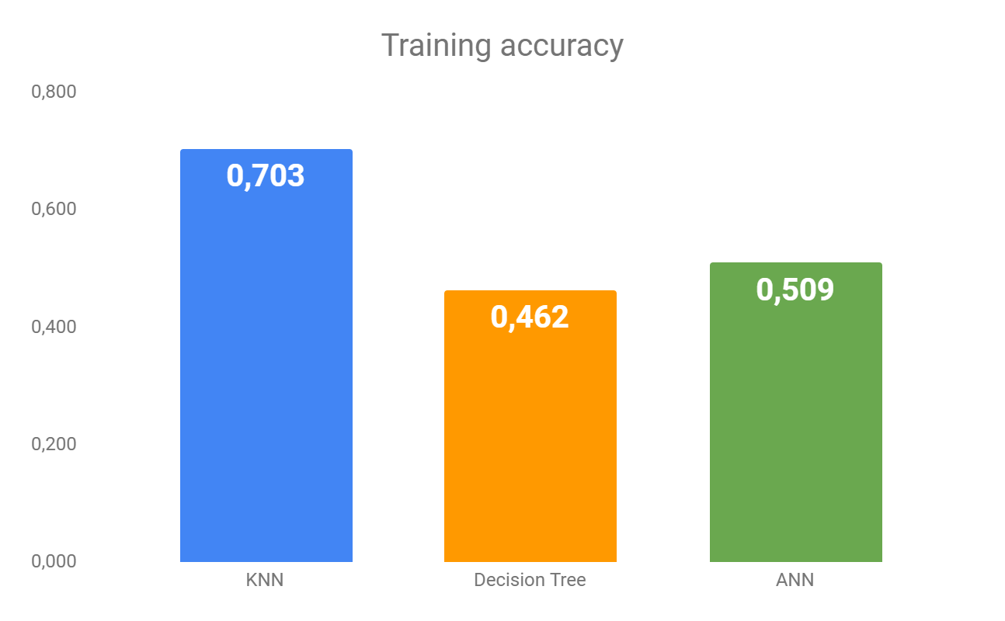
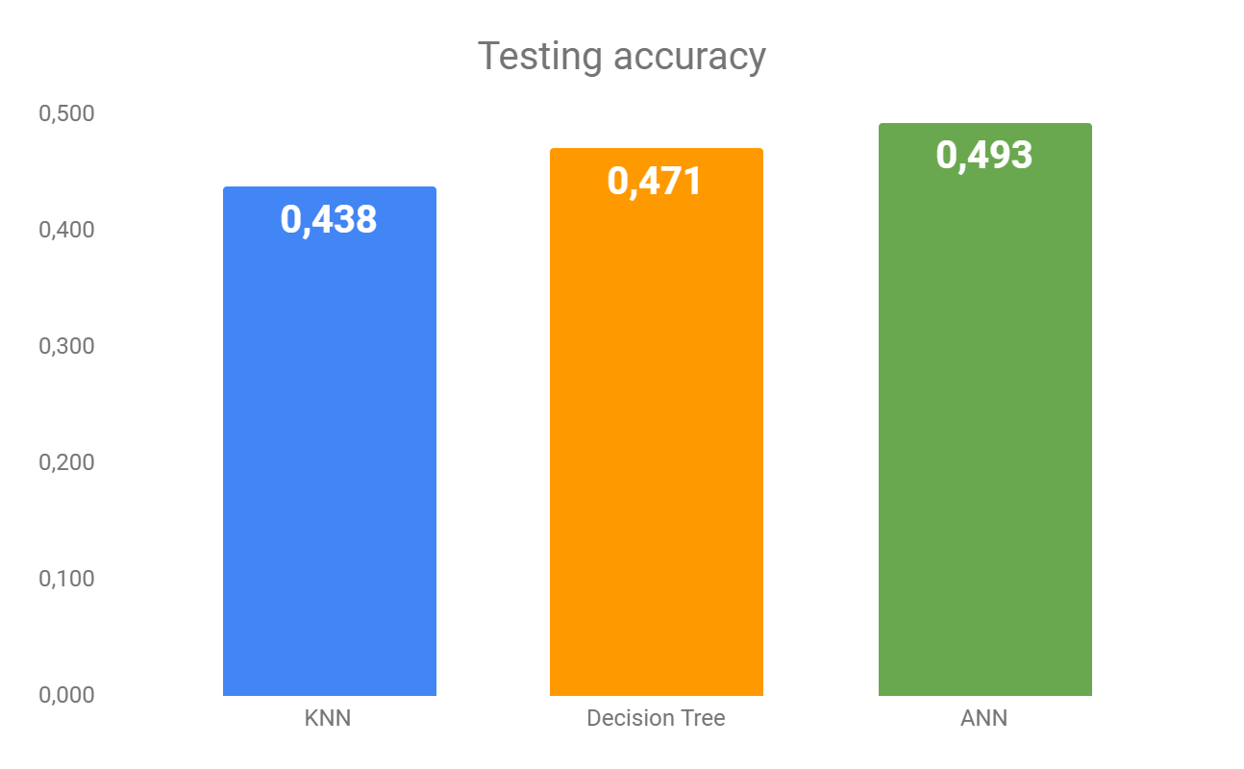
Most effective algorithm
Artificial Neural Network (ANN)
Why I recommend it
Captured relationships
Greater accuracy and flexibility for weather and climate prediction tasks
Adapted better
Stronger performance with multi-variable, long-term datasets
Higher predictive accuracy

Slide 8
Summary (I)
01
02
Hypotheses
Methods chosen
Temperature patterns can predict local climate conditions.
Model complexity increases accuracy (to a point).
Temporal variables improve prediction of climate outcomes
To test these hypotheses:
Cleaned and optimized historical weather data.
Tested three supervised learning algorithms: KNN, Decision Tree, and ANN.
Measured model accuracy using training and testing data.

Slide 9
Summary (II)
03
04
Results
Next steps
ANN achieved the highest predictive accuracy.
Decision Tree performed moderately well but overfit slightly.
KNN was simple and fast but less accurate for complex patterns.
To strengthen future predictions, the next steps could include:
Adding more features (e.g., humidity, pressure, wind speed) to improve prediction accuracy.
Testing other algorithms such as Random Forest or Gradient Boosting.
Expanding the time range or including external datasets (e.g., CO₂ emissions or sea level data).
Visualizing predictions across different European regions to better communicate results to non-technical audiences.

Slide 10
Thank you!
01
02
Andrés González
Contact info
Data analyst
andd011@yahoo.com

